Slide 1
Data visualisations in R
Nosotros aprenderemos un nuevo iodma

Slide 2
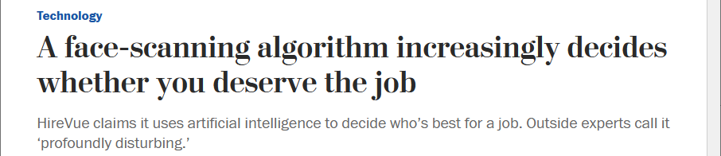

Key skills to become a good scientist
In order of importance
Biological/scientific understanding
Statistical understanding
Many other things…
Programming ability
Focussing on coding skills, leads to…

Slide 3
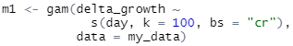
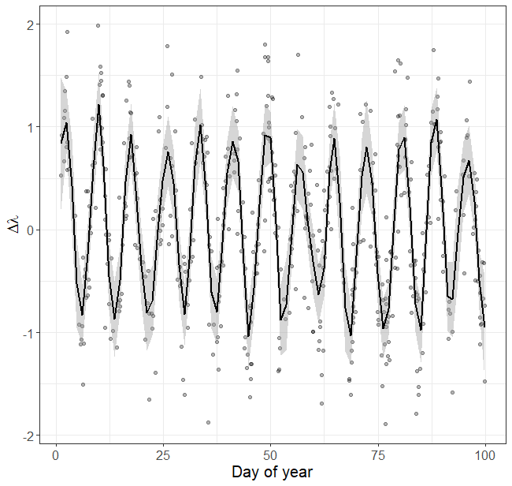
Knowing how to program does not mean you understand the statistics
A common misconception is;
“I can code a model in R, therefore I understand the stats”
Can you copy and paste this code?
Congratulations, you’ve just run a generalised additive model, with growth explained by a function of day of year, allowing a maximum of 100 knots, but effectively using 49.72, for the cubic regression spline basis.

Slide 4
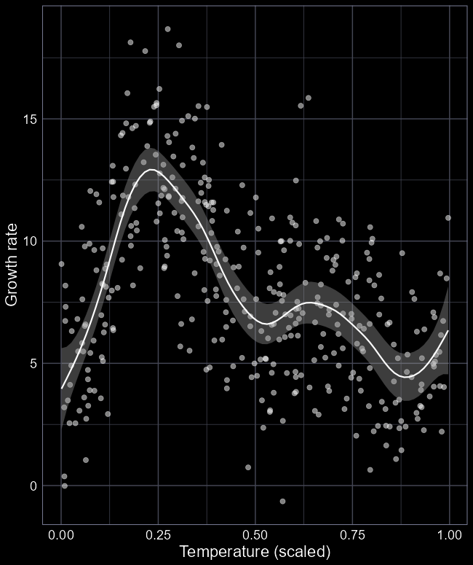

Implementing $≠$ understanding
A common misconception is;
“I can code a model in R, therefore I understand the stats”
Can you copy and paste this code?
gam(y ~ s(x2, k = 50), data = df, method = "REML")
Congratulations, you’ve just run a generalised additive model, with the growth explained by scaled temperature, allowing a maximum of 50 knots, effectively using 9.59, for the thin plate regression spline basis.

Slide 5
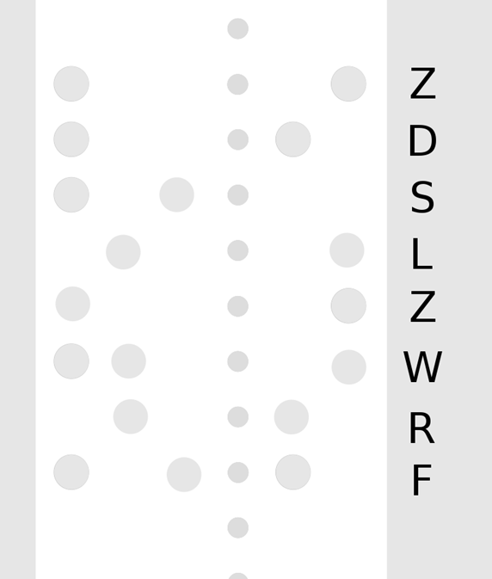
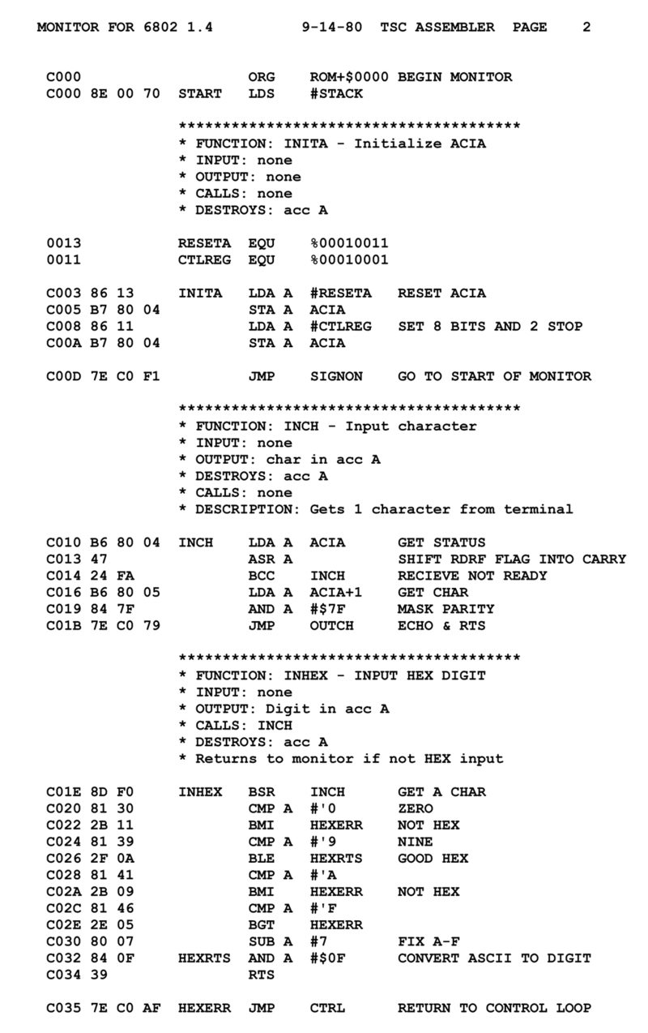
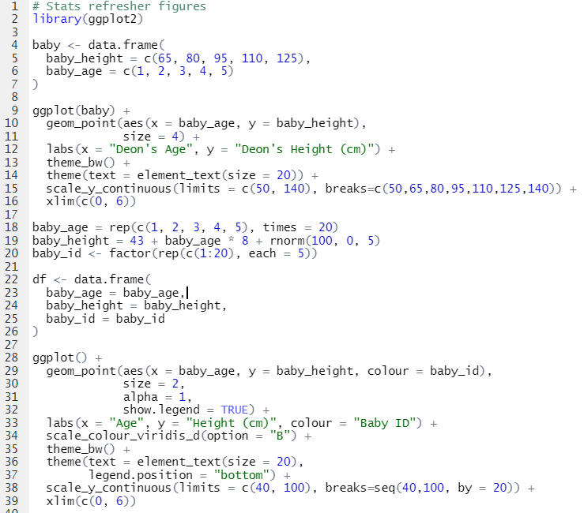
History of programming language
Raw binary code
0001 0110 1011
Low level languages
E.g. Assembly
Still coding in “machine” language
Very early symbolic language
Very difficult to code and debug
High level languages
E.g. R, C++, Python, Java, etc.
Handle conversion of phrases into raw binary
Conversion is called “compiling”
Code is “readable”, using English word

Slide 6


R and RStudio
If you so wanted, you could code directly in R via the “console”
Working directly in the console can be fiddly and cause issues
Imagine writing an essay in Word without being able to save
R is the programming language
RStudio is an IDE
Integrated Developer Environment
An IDE is kind of like the Word equivalent for a given programming language

Slide 7
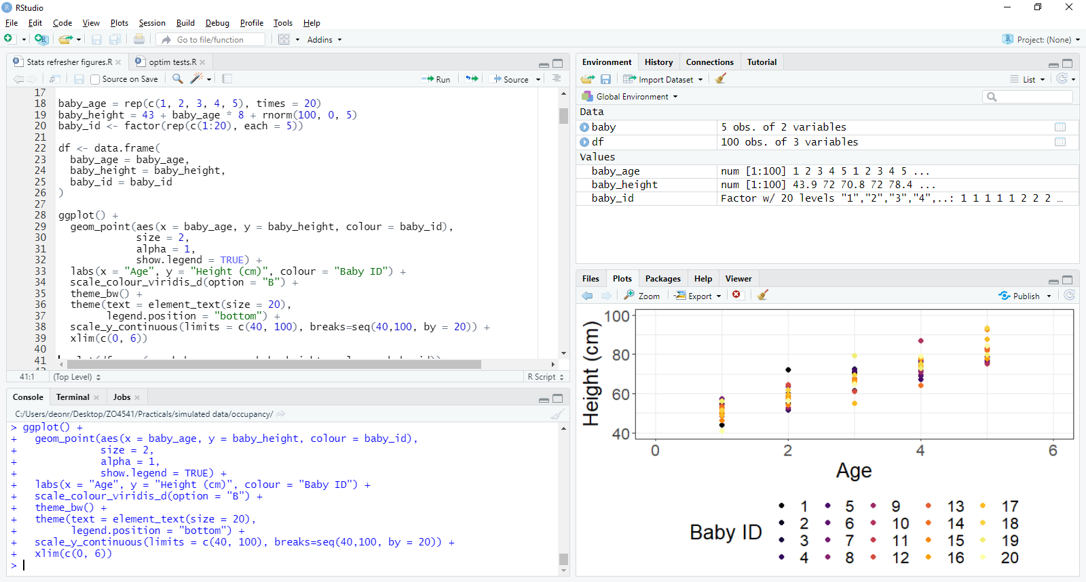
Objects in environment,
e.g. stored data
To run code, either press Run button, or press Ctrl + Enter (Or Cmd + Enter on Mac)
The script editor;
e.g. Word for R
Preview area,
e.g. see plots, animations, etc.
The console;
e.g. Word without “save as”

Slide 8
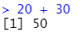
R is a fancy calculator
We can do very simple maths using R
For example, 20 + 30 = ?
In the R console, we can code this as;
20 + 30
The “>” is a console prompt
i.e. “I am ready for code”
If we run the code (i.e. hit “Enter”)
R returns [1] 50
[1] means that this is the first value
And in this case, the only value
50 is the solution to 20 + 30

Slide 9
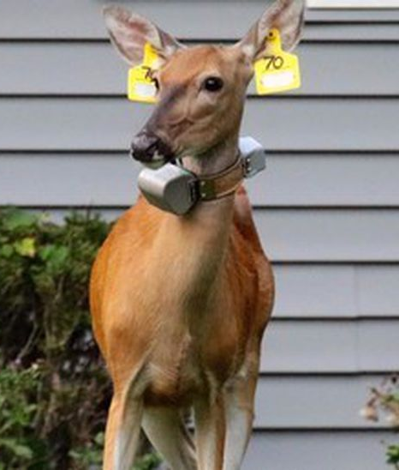

An example
The Lincoln-Peterson Estimator is an equation to estimate the population size
Relies on catching, marking, releasing, then trying to recapture animals
The equation is:
$N= \frac{n_{1}×n_{2}}{m_{2}}$
Where:
$N$ is the total number of animals
$n_{1}$ is the number of animals caught on day 1
$n_{2}$ is the number of animals caught on day 2
$m_{2}$ is the number of marked animals caught on day 2

Slide 10


Assume
In math jargon:
$$N= \frac{n_{1}×n_{2}}{m_{2}}$$
In R:
> 20 * 30 / 10
[1] 60
On day 1 we catch and mark 20 crested newts
On day 2, we catch 30 crested newts
Of which 10 have marks we put on yesterday
Where:
$N$ is the total number of animals
$n_{1}$ is the number of animals caught on day 1
$n_{2}$ is the number of animals caught on day 2
$m_{2}$ is the number of marked animals caught on day 2

Slide 11
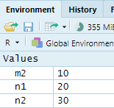
objects
n1 <- 20
n2 <- 30
m2 <- 10
Quite often, you can make your life easier by storing values for later use
We store values (or datasets) as an “object”
You’ll see them appear in your “Environment”

Slide 12
Using stored objects
Now that we have these values stored
We can use them whenever we like
We can even store the output if we wanted to
> n1 * n2 / m2
[1] 60
> N <- n1 * n2 / m2
> N
[1] 60

Slide 13

Functions
At this point, we can do anything we want in R
But doing so would require us to code every single part of the process
Every. Single. Part…
An easier option is to use a “function”
Functions are blocks of organised, reusable code (often written by someone else) that performs a specific action
E.g. logLik(thing)calculates the log likelihood of thing
$$ℒ\left(N,p | data\right)∝\frac{N!}{f_{0}!}\prod_{CH}{P{\left[CH\right]}^{n_{CH}}}×P{\left[y=0\right]}^{f_{0}}$$

Slide 14
Anatomy of a function
Multiple arguments are distinguished with “,”
A function has two main components
a_function(argument1, …)
The name of the function we want to use, always follow by ()
The information (or argument[s]) required for a function to work

Slide 15
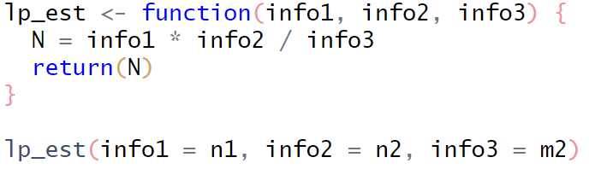

Lincoln-Petersen
This is my home made function
It runs the Lincoln-Petersen Estimator
And returns, to the user, the estimated population size
I, the creator of the function, decided to call my arguments (i.e. the bits of information my function needs) info1, info2 and info3.
Because we already had n1, n2 and m2 stored as objects, we can just pass them to the function
$$N= \frac{n_{1}×n_{2}}{m_{2}}$$

Slide 16
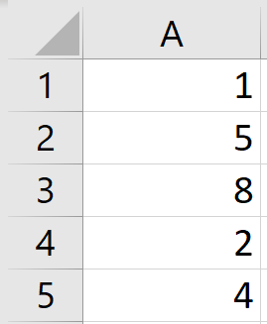
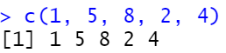
Function examples
Say we had five values (1, 5, 8, 2, 4) which we want stored as a column of data
This is, conceptually, a very trivial task, but to code it by hand is surprisingly complicated
So instead, we can use a function to keep the task simple
The function is called concatenate in English, or c() in R
([1] refers to the index, R indexes from 1, not 0)

Slide 17
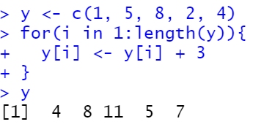
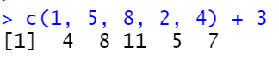
The reason why people started using R
Say we wanted to add 3 to each value in our column of data
In most other languages, this would require some “heavy” coding
Via something called for loops
R is sometimes referred to as a vectorised language
This means that we can use a whole column of data when doing maths/stats
(Nowadays, people use R cause everyone else uses R)

Slide 18




Common R mistakes
Using wrong argument name
E.g., there is no a argument
Typos
E.g., extra commas
E.g. typo in function name
E.g. not closing brackets
If you get a warning you do not understand, paste it into Google!

Slide 19
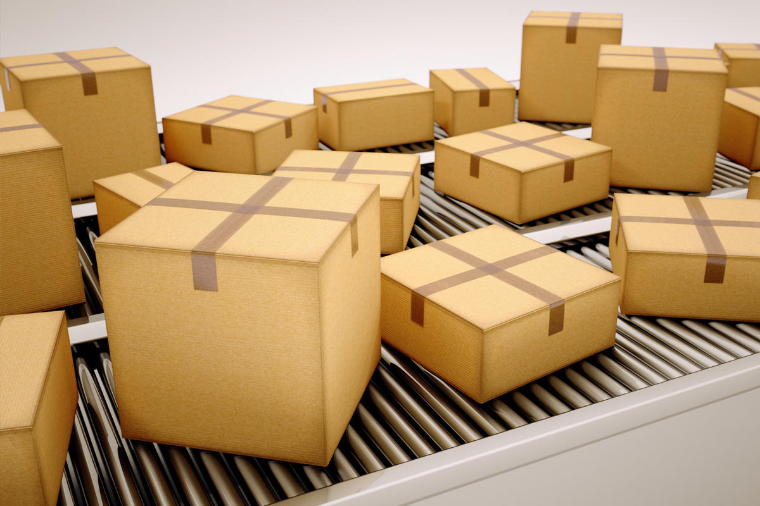
Getting more functions into R
The base version of R has many functions
But these are general purpose functions
E.g. mean()
In many cases we want to do some niche/specialised analysis, requiring specialised functions
This is the big benefit of R
Open source, so lots of people contribute to the software
To get additional functions, we need to install a “package”
“Package” because it is a package of functions

Slide 20
Getting more functions into R
The base version of R has many functions
But these are general purpose functions
E.g. mean()
In many cases we want to do some niche/specialised analysis, requiring specialised functions
This is the big benefit of R
Open source, so lots of people contribute to the software
To get additional functions, we need to install a “package”
“Package” because it is a package of functions

Slide 21
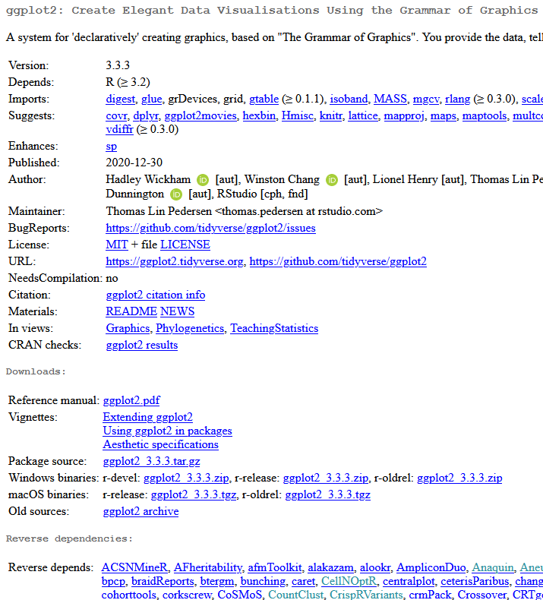
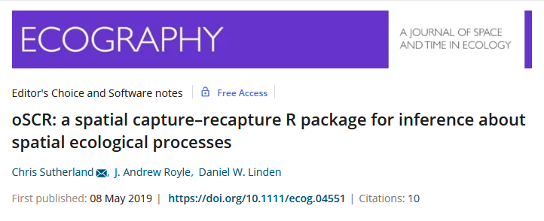
What is a package?
A package is a collection of code, and resulting functions, which you can freely download whenever you please
Stored in an online repository called “CRAN”
Packages are often described in published papers
Especially true for packages which are used for statistical analysis
A major benefit over, e.g., Python

Slide 22
To install a package;
Relatively simple process;
Write the code to download the package (in R)
install.package(“ggplot2”)
We use quotes to help R find the correct package
(searches for a string)
Once installed, it is on your computer
To actually use it, we need to load it in R
library(ggplot2)
We do not need quotes any more because R knows what it is
The function is called library, because we have a “library of packages”
Each time we open R, we will need to reload the package

Slide 23
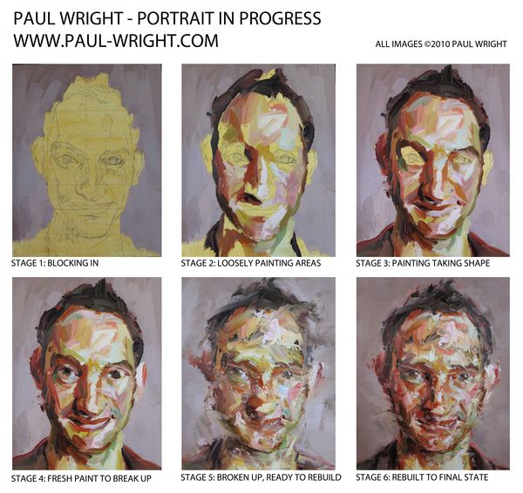
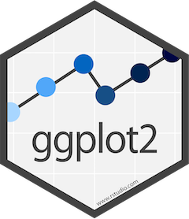
Data visualisation toolkit
We’ll use R and an R package called ggplot2 to create figures
gg stands for “Grammar of Graphics”
Based on a “design philosophy”
Think of using ggplot like the progression of a painting
You create layers of “paint” one at a time
We can change any layer at any time
Familiarity with ggplot often requested by employers (e.g., spotify)

Slide 24
First hurdle: get ggplot2
Install and load ggplot2 into R
install.packages(“ggplot2”)
library(ggplot2)
If you don’t do this, then R won’t know what you’re trying to do!

Slide 25

ggplot layers
ggplot(data = unicorn)
We tell R to use the unicorn data
Creates a blank canvas

Slide 26
ggplot layers
ggplot(data = unicorn)+
We add a new layer to the painting

Slide 27
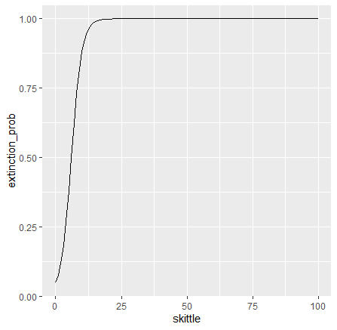
ggplot layers
ggplot(data = unicorn)+
geom_line(aes(x = skittle, y = extinction_prob)
We say the geometry will be a line
We need to specify the aesthetics, using aes()
We decide what will be on the x and y axes

Slide 28
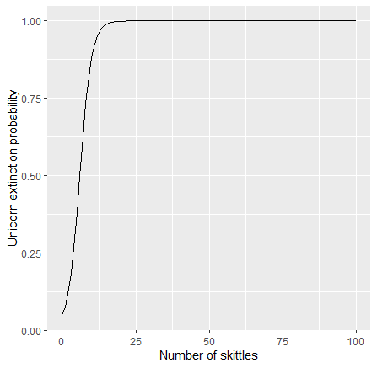
ggplot layers
ggplot(data = unicorn)+
geom_line(aes(x = skittle, y = extinction_prob)+
labs(y = “Unicorn extinction probability”,
x = “Number of skittles”)
We can change the labels (labs) of the axes

Slide 29
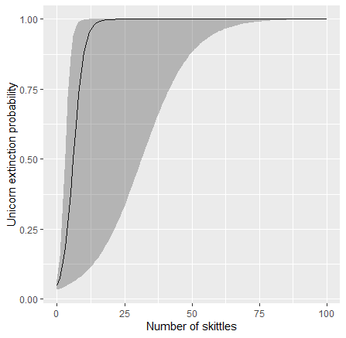
ggplot layers
ggplot(data = unicorn)+
geom_line(aes(x = skittle, y = extinction_prob)+
labs(y = “Unicorn extinction probability”,
x = “Number of skittles”) +
geom_ribbon(aes(x = skittle,
y = extinction_prob,
ymin = extinction_prob_lwr,
ymax = extinction_prob_upp),
alpha = 0.3)
We can use 95% CI to create a ribbon to show uncertainty.
And make the ribbons 30% transparent

Slide 30
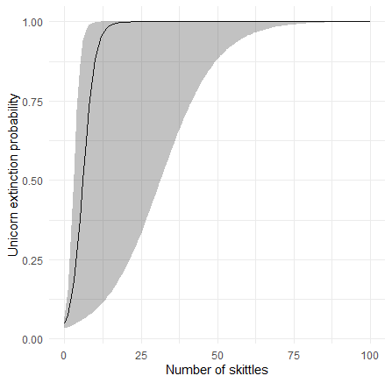
ggplot layers
ggplot(data = unicorn)+
geom_line(aes(x = skittle, y = extinction_prob)+
labs(y = “Unicorn extinction probability”,
x = “Number of skittles”) +
geom_ribbon(aes(x = skittle,
y = extinction_prob,
ymin = extinction_prob_lwr,
ymax = extinction_prob_upp),
alpha = 0.3) +
theme_minimal()
Use a minimal theme to get something more pleasing

Slide 31
You can move layers to suit your need
The order that you arrange the layers will determine what you see in the final figure.
Want ribbons behind the line? Move the ribbon layer earlier.
ggplot()+
geom_ribbon(aes(x = skittle, y = capture, ymin = capture_lwr, ymax = capture_upp),
alpha = 0.3) +
geom_line(aes(x = skittle, y = capture)+
labs(y = “Unicorn capture rate”, x = “Number of skittles”) +
theme_minimal()

Slide 32
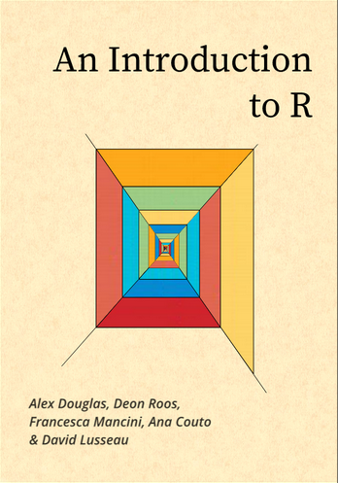
For more material on learning R
https://intro2r.com

